Slide 1

Project Title - Reducing Single-Use Plastic(Usage of Plastic Spoons)
Submitted by: Team Starks
Shiva Sai | 12212497 | K22GT36
Bilal | 12203781 | K22GT15
Nandu | 12203167 | K22GT29
Bharath | 12205425 | K22GT25
Submitted to: Pooja mam
Course Code: CSD-233

Slide 2
TABLE OF CONTENT
TOPIC | SLIDE NUMBER
INTRODUCTION | 3
WICKED PROBLEM | 4 to 6
PROBLEM FRAME | 7 to 8
AEIOU FRAMEWORK | 9 to 10
ETHNOGRAPHIC RESEARCH PLAN | 11 to 15
INTERVIEW PLAN | 17 to 20
EMPARTY MAP | 21

Slide 3
TABLE OF CONTENT
JOURNEY MAP | 22
USER PERSONA | 23 to 26
5-Whys TECHNIQUE | 27
STAKEHOLDER ANALYSIS | 28 to 30
POINT OF VIEW STATEMENT | 31
HOW MIGHT WE’ QUESTIONS | 32
FINAL DESIGN BRIEF | 33 to 34
Idea and prototype | 35 to 40

Slide 4
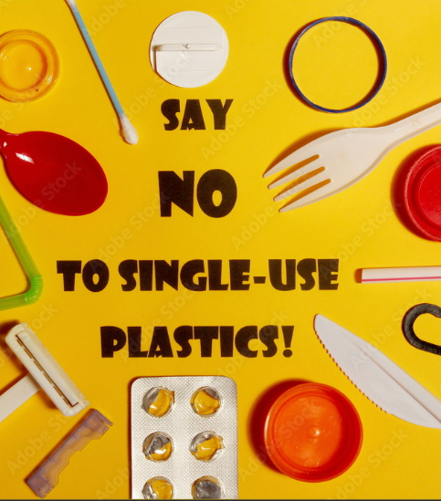
Introduction -
Single-use plastics comprise over 40% of total plastic consumption in India. The country is generating 3.5 million tons of plastic waste every year. Shockingly, only 40% of it is collected, resulting in severe pollution in rivers and urban areas. According to various research studies, plastic pollution affects more than 1,000 species. On the Indian coast alone, up to 20,000 metric tons of plastic waste are collected annually. This growing dependence on plastic has a lot more impact than just the pollution of the ecosystems. People are also exposed to increased health risks because microplastics are increasingly found in food and water supplies.
Source - Ministry of Environment, Forest and Climate Change (MoEFCC), Government of India - Regularly publishes reports and data on plastic waste management, including initiatives to reduce single-use plastics
Website: moef.gov.in

Slide 5
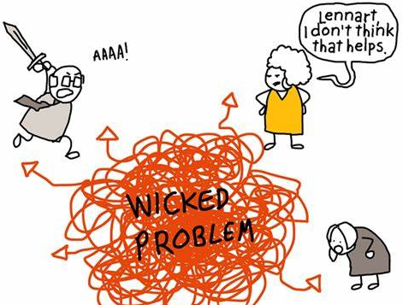
Wicked Problem
Wicked Problem is something that is not clearly defined.
It is difficult to control or stop the usage of single-use plastic
It is a wicked problem because single-use plastic is difficult to handle and impacts everything: from the environment to human health. It is cheap and convenient, so people and industries use it heavily, but it's tough to recycle and often ends up as waste. This waste pollutes land and oceans, harming wildlife and ecosystems. Because plastic takes hundreds of years to break down, it builds up over time. It would require big changes in production, habits, and waste management, thus making the issue very complex and difficult.

Slide 6
INDICATORS OF WICKED PROBLEMS
Indicator of wicked problem… | How/where we see this for the industry problem
1) No definitive formulation | There are many ways to look at the problem of single-use plastics, including that of production, consumer demand, and recycling, which causes a struggle as to which approach to go with.
2) No Stopping Rule | There are huge number of products so we can control many at maximum but not all so no end for this.
3) Solutions are not true or false, but good or bad | We will relace it with other materials like paper, might sound looking good at a first glance, but may lead to other environmental harm in increased forestation thereby showing not all solutions are equally good.
4) No immediate/ultimate test of a solution | It takes much time and quite challenging to measure its success after implementation to get better results
5) Every solution is a one-shot operation | While going with alternatives, if the consumer is not favorable to this solution, they might never use it again which stresses the problems of one-time approaches toward solutions

Slide 7
6) No enumerable set of potential solutions | There are various strategies to address but all can be controlled up to a certain amount or stage only but all completely
7) The problem is unique | The challenge faced by a beach town with tourists using single-use plastics is different from that of an urban area with better recycling facilities, highlighting how specific circumstances can influence the issue
8) The problem can be considered the symptom of another problem | This reliance on convenience can overshadow the need for more eco-friendly choices, as individuals may opt for single-use products for their simplicity rather than considering their long-term environmental impact.
9) The existence of discrepancies | Businesses may support reducing single-use plastics for marketing purposes while resisting changes due to cost, leading to conflicting views on the best approach to tackle plastic waste.
10) The planner has no right to be wrong | If a city council implements a plastic ban and it results in higher costs or issues for local businesses, the decision-makers face pressure to avoid mistakes, knowing that failures can have significant consequences.

Slide 8
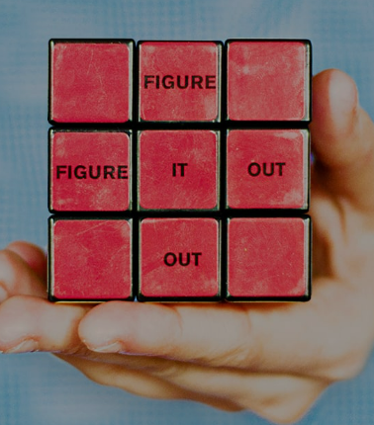
PROBLEM FRAME
What is your initial problem ‘frame’? Who’s eyes are looking at the problem through?
How might we decrease or completely eliminate the single-use plastic spoon from entering the environment, taking into consideration both the functional needs of consumers and the ecological footprint of production and waste?
The consumers, businessmen, vendors, and manufacturers are part of this.

Slide 9
What other possible frames might there be for this problem?
Health and Safety Frame Focuses on ensuring hygiene and safety standards that are usually linked to single-use plastics. Aims to create alternatives that uphold these essential qualities.
Cultural and Social Norms Frame Explores how single-use items are ingrained in the fast-paced dining culture. Seeks to change attitudes and behaviors towards more sustainable choices.
Waste Management and Recycling Infrastructure Frame Addresses the challenges of disposal and recycling for single-use plastics and their alternatives. Emphasizes the need for compatibility with current waste management systems.
Educational and Awareness Frame Increases awareness about the environmental effects of plastic spoons. Promotes behavioral changes through campaigns and informative labeling.
Lifecycle and Material Innovation Frame Looks at sustainable materials and the complete lifecycle of the spoon. Concentrates on production methods, durability, and the impact of disposal.
Economic Accessibility Frame Focuses on overcoming the cost barriers associated with sustainable alternatives. Strives to make eco-friendly spoons affordable for all consumers and businesses.
Convenience and Functionality Frame Ensures that the convenience and practicality of single-use plastic spoons are preserved. Works on developing functional, sustainable options suitable for on-the-go use.

Slide 10
AEIOU FRAMEWORK
ACTIVITIES | ENVIRONMENT | INTERACTIONS | OBJECTS | USERS
Cafes and Bakeries: preferred to eat deserts and consuming soups. | Plastic spoons are mainly found in fast-food chains where they are provide them with takeaway meals (Ex: McDonald's, KFC) | Industries interact with food service industries to produce large number of spoons according to the demand. | Kitchen Utensils for mixing up of small ingredients. | Consumers who are comfortable to use and free of cost at fast food center.
Flight & Railway Meals: provided by airlines and railway services to enjoy the meals | Widely used at large public gatherings such as marathons, sports games where catering services rely on plastic spoons. | suppliers provide plastic utensils in bulk to restaurants, event organizers with low cost. | Gardening Tools for labelling a plant or a seed. | Event organizers who consider to be easy to use and not to make place unclean with water.
Household Backups: when dishwash is not preferred to wash and to make it easy | packaged food include plastic spoons for customer convenience. | people participate in awareness campaigns which describes negative impacts of single-use plastic | Creative material for Sculptures and decorations. | Employees/ workers who are working in companies .

Slide 11
ACTIVITIES | ENVIRONMENT | INTERACTIONS | OBJECTS | USERS
Office lunches: To complete meal in a given period especially during lunch breaks | Households uses plastic spoons for convenience during casual gatherings and for kid’s parties. |  | Used for painting or craft and art | Teachers uses plastic spoons for classroom activities allowing students to engage in hands-on learning experiences.
Fast-food center: Primary location for single-use plastic spoons, especially for takeout orders.
Events: used at events, parties, and picnics for convenience.

Slide 12

ETHNOGRAPHIC RESEARCH PLAN

Slide 13





What are the sights/people that you are planning to study?
Manufacturers: Companies such as RATAN IMPLEX and MR.PLAST manufactures single use plastic spoons. They may need to do something new alternatives by exploring sustainable materials that do not affect the environment.(ex wooden spoons)
Waste Collection Workers: -Members involved in collection and storing of waste(mainly plastic) . They explain the challenges of recycling plastic spoons and where most of the waste end up. (separation of different kinds of plastic)
Environmental Activities and Organizations: Groups working to make environmental sustainable by various methods. They advocate public to use reusable/eco-friendly products and make them aware how single-use plastic affect the environment
Food Outlets: Fast-food centers and cafés provide plastic spoons along with the order. Consumer habits may influence how demand affects choices to use eco-friendly products. (ex: price)
Consumers: Regular use of plastic spoons in takeaways and delivery. We will explore their preferences for convenience, awareness of environment and ways for alternative materials.

Slide 14
How do the sites you have chosen(or have access to) impact your research questions?
These people can provide best inputs of entire life-cycle of single use plastic
-Spoon manufacture companies understand challenges they faced while adopting eco-friendly products. This shows why plastic spoons are still in demand even availability of sustainable products is more.
-Observing and interviewing food outlets shows how often customers use plastic spoons. we can understand if they allow sustainable products how importantly these are presented to influence customers for eco-friendly materials.
-waste collection members who involved in collection and storing plastic helps us to understand and explain the challenges of recycling plastic (separation of different kinds of plastic)
-Environmental activities and organizations share insights of the challenges they face in promoting to use sustainable practices. Their ideas helps us to shift for eco-friendly alternatives.
What kind of relationship did you hope/plan to establish with your research subjects?
Our aim is to maintain collaborative and respectful relationship and ensure they feel comfortable to share their honest reviews. We plan to have trust and empathy when discussing environmental impacts on using plastic spoons. We will approach each conversation with more focused by respecting their perspectives and thought process.

Slide 15




How did you plan to collect and organise data?
We like to collect data through
Observations: visit food outlets to observe how spoons are provided to customers and if possible sustainable alternatives are available and how customers reactions to these options.
Interviews: conducting interviews with food outlets/cafe managers, consumers. This will help to focus on challenges that are facing to adopt eco-friendly materials and motives for choosing sustainable products.
Surveys: conducting surveys with the large number of consumers to identify the usage and the awareness on the environment.

Slide 16
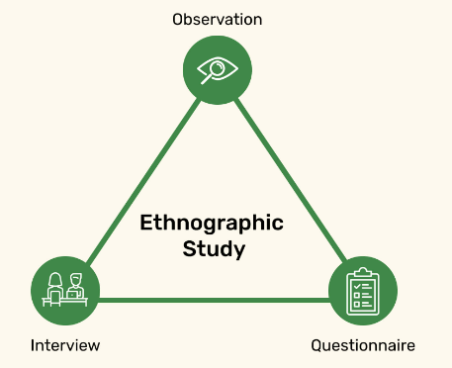
What do you learn from your ethnographic research?
Consumers:
-I learned that consumers who are convenience of using plastic spoons without thinking much about the environmental impact even they are aware of the impact.
-Even who aware of sustainable products still favour to use quick and disposable option mainly in food outlets.
-price of sustainable products will play major role. As the cost of plastic spoons are cheaper compared to sustainable one so they prefer to use plastic over eco-friendly.

Slide 17
What do you need to be aware of when writing about your findings?
Context: need to communicate about environmental issues of using single-use plastic, framing the findings and need to explain how this matter for both consumer and environment.
Confidentiality: respecting the privacy of interviewer mainly who likely to share their personal opinion.
Balance: mention both challenges and opportunities for eco-friendly practices by taking acknowledgement from manufacturers, food outlets, consumers
What academic materials were relevant to this process?
Study on environmental sustainability and consumer behaviour related to single use plastic which provide information why people show interest to choose convenience over sustainability.

Slide 18

INTERVIEW PLAN

Slide 19
Who did you interview and why?
Interviews: A software employee, a college student, and a fast food worker.
Reason for Selection: These customers represent the everyday pliers of single-use plastic spoons, each with reasons for using these products and obstacles that reflect the general industry dilemma of plastic waste. The specific nature of their behavior and needs shows how this problem plays out with different types of people-from convenience-driven workers to cost-conscious students and mobile food service employees.
Intention Clarification: Intent Statement: Understand how everyday motivations, habits, and barriers keep people using single-use plastic spoons to understand how to design something more practical, and appealing.
Building Report
Start with Friendly Chit-Chat.
Start with casual, light-hearted questions about their day or their interests to warm them up. For instance, ask them about their favorite lunching spots, how they study, or new projects at work.Relate to Their Experiences:
Please share a small personal experience or story relating to the issue, with real interest and empathy with their routines and the choices that they made.
Express gratitude for his time and deliberation.Express that their thoughts are valuable and will directly influence meaningful solutions. Let them know that their input will help create products or practices that benefit others with similar needs.
Use open-ended questions Encourage them to be open by asking questions that will allow them to share their experiences freely without fear of judgment.

Slide 20
INTERVIEW QUESTIONS
During what situations do you tend to use plastic spoons, for instance, are they used during parties, take out food, have a picnic?
What makes it easy to use plastic spoons when there are other options that are reusable. What are the considerations (e.g., convenience, cost, availability)?
Do you know that plastic cheeseburgers are a textbook example of using disposable plastic spoons? Do you think this affects your actions in any way?
What problems do you encounter when you try to use greener options (shock price, inconvenience, hard to find)?
What would you use in place of plastic spoons if they were no longer in use?
In a typical day, how often do your customers purchase disposable plastic spoons compared to wooden or reusable ones?
Do you feel that there has been any change in the purchase of plastic single use items over time?
In your opinion, how do the costs, availability, or desire for an eco-friendly replacement of plastic spoons impact sales or promotion of such products?
Could you reduce sales of the plastic spoons if the demand for the substitutes was greater and provided there was enough market competition?
How in your opinion do you see the sales of the single-use plastic spoons progressing over the years?
In your transition towards utilizing more eco-friendly products, what constraints do you face, such as cost or technology. How about market demand?
What, if anything, is your company doing to lessen the ecological consequences of your products?
In your opinion what innovations practical or technological would have to evolve to make the eco-friendly options more practical in the market?

Slide 21
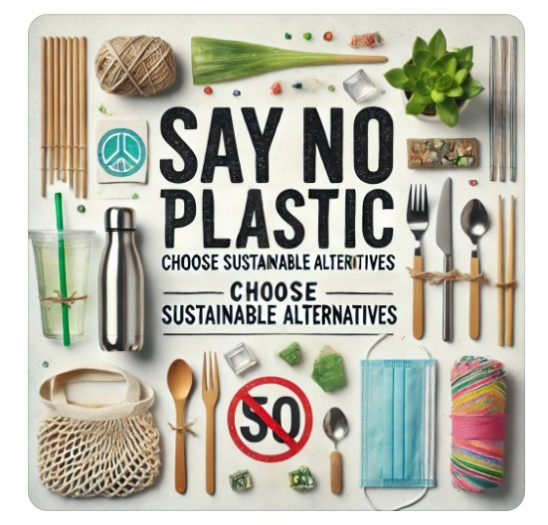
Interview Takeaway
Interview 1: Software employee
usage: Mainly for quick lunches in the office.
Why Plastic? Convenience and no need for cleaning.
Eco-friendly concerns: Find greener alternatives much less practical and costlier.
Ideal Solution: Cheap, throwaway, easy-to-use, and eco-friendly solution.
Interview 2: Student
Usage: Munching between classes; a plastic spoon usually comes with takeout.
Why Plastic? Inexpensive and available.
Eco-friendly Concerns: Alternatives are not as easily accessible and more expensive.
Ideal Solution: Inexpensive and accessible, eco-friendly, disposable.

Slide 22
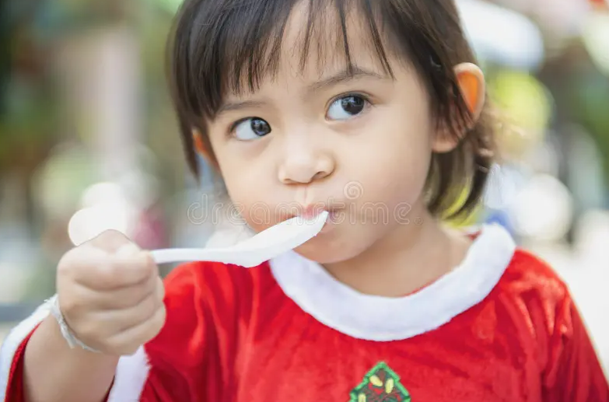
Interview 3: Fast Food Employee
It gives plastic spoons to customers as an initiative of employment.
Why Plastic? Fast, cheap, and reliable for service.Eco-Friendly Concerns: Alternatives tend to be sensitive and costly.
Ideal Solution: A long-lasting but inexpensive green product meeting fast service requirements.Common FindingsConvenience & Cost: Same factor for all.
Problems: Eco-friendly spoons are less available, expensive, and not very convenient.
Solution Features include: Low-cost, long-lasting, readily recyclable, and environment friendly.These results clearly indicate that the "eco-friendly" option should not compromise on convenience or cost-addition.

Slide 23

What do they HEAR?
-warning about the environmental impacts of plastic by media and environmental advocates
-marketing messages from businesses that encourage sustainable choices.
Who are we empathizing with:
People who prefer priority to use convenience and ease such as dinners, takeaway customers, and events.
GOAL:
-aim to minimize their environmental cause
-seek alternatives that balance convenience and sustainability.
-quick and disposable utensils without the need for cleaning.
What do they need to DO?
-make easy and quick decisions that fit into their busy lifestyle.
-considering reducing single-use plastic consumption if alternatives are available
-choose products that benefit from both convenience and environmental needs
Hearing
Empathy Map
Seeing
What do they SEE?
-limited options for eco-friendly products, depending on location and price.
-Awareness and signs in certain places promote sustainable choices.
What do they SAY?
-just one spoon, how much impact does it have on the environment
-It is convenient but I don’t feel what impact it has on the environment
pAINS
gAINS
Worry about contributing for plastic waste and environmental harm
Frustration when sustainable materials are expensive or unable to find/get
Worry about long term impact on marine life and the Earth
Convenience to use and no need to wash and carry
Relief when they find products that are eco friendly
Reduce guilt as they feel responsibility got fulfilled

Slide 24
Journey Map
Scenario: An employee orders lunch at the office canteen that comes along with a single-use plastic spoon
Step1
Step2
Step3
Step4
take convenient utensils to enjoy his meal
Decide to eat lunch
Employee finishes meal and looks to dispose of them.
Employee reflets on lunch experience
GOAL: to get a meal during break without hassle.
DOES: -receive take order along with the plastic spoon
-consider the convenience of having a meal with plastic.
-feel confident to use plastic but do not want to waste his time
OPPORTUNITIES:
-encourage restaurants to provide sustainable utensils
-offer reusable utensils to people to use
GOAL: enjoy a meal during break comfortably.
DOES:
-use a plastic spoon to eat
-consider to bring own reusable utensils next time
-guilt on environmental impact.
OPPORTUNITIES:
-provide a spot for reusable utensils in the office
-can distribute reusable utensils as part of the employee welcome kit.
Goal: dispose of utensils without causing harm to the environment.
DOES:
-look for the trash bin.
-frustration if no proper disposal is available
OPPORTUNITIES:
-can set labeled recycling and compost bins in the office.
-option for employees to return reusable utensils for cleaning.
GOAL: feel positive about their break time
DOES:
-leave the place by feeling guilty of using plastic spoons.
-think thoughts about sustainability about their colleagues.
-worry about making eco-friendly in the future.
OPPORTUNITIES:
-implement feedback for employees to share experiences.
-reward options for employees for consistent use odd sustainable options
-Share success stories who made eco-friendly

Slide 25
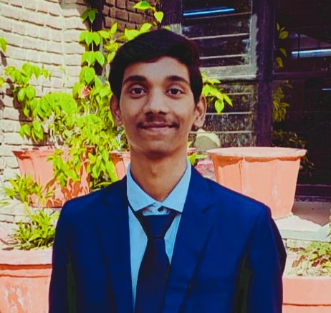
Persona 1: College Student
Persona Name: Nandhan
Age: 20
Job: University Student (Aspiring web developer)
Personality: budget-conscious, socially aware, enthusiastic about sustainability but constrained by financial situation
Goals / Motivations: making choices for sustainability as part of her lifestyle, but also within her student budget
Wants/Needs: low-cost, accessible, ecologically responsible alternatives to plastics. he is inspired to make a difference but does not want to take on too much and be expensive.
Picture

Slide 26
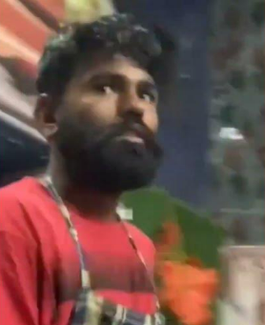
Persona 2: Fast Food Server
Persona Name: Aman
Age: 26
Occupation: Fast Food ServerPersonality Practical, efficiency-oriented, routine-bound, environmentally conscious but limited by job considerations
Goals / Motivations: Serve food quickly and efficiently without wasting any of his products.
Wants/Needs: Solutions for reducing plastic in the restaurant that won't compromise speed of service, customer satisfaction. He's willing to adopt eco-friendly alternatives if they are easy to implement and integrate into the restaurant's flow.
Picture

Slide 27
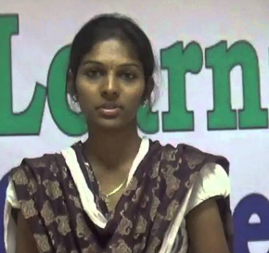
Persona 3: Software EmployeePersona
Name: Bhavya
Age: 24
Occupation: Software Engineer(Capgemini)
Personality: Tech-savvy, detail-oriented, green at heart, but short on time
Goals / Motivations: Gradually reduce plastic use while juggling a busy workload.
Wants/Needs: Quick, convenient solutions that remind her to live better, not harder. she wants sustainable choices that don't compromise his fast-paced, tech-driven lifestyle.
Picture

Slide 28
5-Whys TECHNIQUE
WHY | Question | Response
1 | why do you usually go for plastic spoons instead of, like, a reusable one? | its comfortable to use and low cost
2 | Why do you think being green is less important than convenience and cost? | reusables or biodegradable spoons feel like too pricey to use compared to plastic one.
3 | Why its cheap compared to what? | Compared to wooden or biodegradable spoons it is cheap because of materials they use in manufacturing.
4 | Why is it that biodegradable spoons are so much more expensive to produce? | Biodegradable products require certain processes and materials, so its expensive compared to plastic one.
5 | Why don’t you consider wooden spoons or alternatives? | It is not available everywhere and higher in price.

Slide 29
STAKEHOLDER ANALYSIS
Internal Stakeholders
External Stakeholders
-Companies: these supply plastic spoons to the food service departments, which generally affect when demand shifts towards sustainable products.
-Sustainable Alternatives Suppliers : offering biodegradable or reusable utensils to the alternatives of plastic.
-Local Communities: communities around waste disposal sites affected by plastic waste mostly when single use plastic’s are not managed properly.
Fast Food chain Management : Owners and managers of fast-food outlets who make decisions for utensils.
-Fast Food Workers(Employees) : Workers who handle utensils and maintain communication with customers may have operational concern to plastic’s use.
-Sustainable Teams : teams with larger food corporations responsible for promoting sustainable activities.

Slide 30
Identifying Stakeholders interests:
who are the main stakeholders in your problem?
-Customers : need convenience and affordability by increasing aware of in sustainable products.
-Fast-Food Management include owners : balancing customer satisfaction, cost.
-Environmental organizations: aim to reduce reduce single use plastic and decrease pollution.
-Plastic Suppliers : used to maintain demand for the products in market with worth full charge.
Who is affected by the problem?
-Environment and local Communities: impact of single-use plastic all over the areas ,landfills, oceans.
-Customers: experience environmental effect in their communities mainly on health while burning them.
-Fast-Food Stations: cost affected if all the customers encourage only sustainable products.
Who appears to be causing it?
-Fast Food Chains: who choose single-use plastic for convenience.
-Plastic utensils manufacturing companies : by supplying these products in large quantities.
-Consumers: demand for single-use convenience products.

Slide 31
Display Relationships
What is the degree of involvement and scope of influence?
Customers: high influence due to their choices. A shift in customers preferences to sustainable resources can prompt businesses to adopt alternatives.
Fast-Food Management : strong influence in organization while taking decisions and can implement sustainable practices.
-Environmental Organizations : indirect influence through advocacy , raising awareness and influence policy.
Government Bodies : high influence due to regulatory power to impose restrictions.
Evaluate and Analysis
Expectations of the stakeholders?
-Customers:
Expectation: want a convenient and clean option for eating, usually without additional cost. Growing number also want to adopt sustainable practices.
-Fast-Food Chain Management :
Expectations: need to maintain profitability while satisfying customer preference and possibly adhering to regulations.
-Environmental Organizations:
Expectations: find the reduction of single-use plastic. They advocate for long term solutions to address plastic pollution.
-Plastic Utensil Suppliers:
Expectation: aim to keep their market share but may also explore options for sustainability products if demand shifts.

Slide 32
ESTABLISH A POINT OF VIEW (POV)
College Student: Nandhan
POV Statement 1: Nandhan requires greener, affordable options since she is environmentally concerned but has a tight budget.
POV Statement 2: Nandhan requires easily available green options so that she can make a responsible choice and does not go over her budget.
Fast Food Worker: Aman
POV Statement 1: Aman wants to serve utensils that are environmentally friendly yet available without slowing the service.
POV Statement 2: Aman also wants his restaurant to be sustainable as he believes in environmental responsibility but does not want this to compromise the work.
Employee Software: Bhavya
POV Statement 1: Bhavya wants easy, user-friendly green choices because he's after waste reduction without extras going on his already chaotic workday.
POV Statement 2: Bhavya just needs simple, sustainable products, he cares about the Earth but can't make significant changes.

Slide 33










‘HOW MIGHT WE’ QUESTIONS
How can we make eco-friendly spoons more convenient to the busy professional who needs something quick and easy?
How might we design sustainable spoons that aren't going to disrupt the busy work environment?
How might we bring down the cost of making eco-friendly utensils so they're affordable to professionals on a modest budget?
How might we help people make sustainable choices without having to make extra effort for it?
How could we make the eco-friendly spoon affordable to poor-students budgets?
How might we design friendly-to-workers handling and serving fast food ecologically friendly spoons?
How might we engineer sustainable plastic-spoon alternatives suitable for a fast paced, on-the-go lifestyle.?
How might we engineer sustainable plastic-spoon alternatives suitable for a fast paced, on-the-go lifestyle.?
How might we envision and design a low-cost, simple way to handle and use eco-friendly spoons in everyday lives?
How might we reduce the environmental impact of plastic spoons in fast food restaurants while still maximizing efficiency for workers?

Slide 34
FINAL DESIGN BRIEF
Final Understanding: The main problem of plastic spoons is that they are harmful to the environment. People like using plastic spoons because it's cheap and easy to use. More eco-friendly spoon for use without much force on people daily. We came up with this conclusion by talking with people and understanding their habits that the problem is now big due to the fact that plastic waste keeps piling up and causes pollution. Now is the time to act, because we have a planet to save and we need to put an end to the use of plastics.
Target Users: Consumers who use plastic spoons, like busy workers, students, or anyone who eats takeaway food.Businesses like restaurants, fast food chains, and food delivery services that use disposable plastic spoons. These users will benefit from a spoon that’s easy to use, better for the environment, and can replace plastic without causing any problem.
Project Aims: If we can, we will be able to give alternatives that are simple and eco-friendly for spoons so that people can replace the plastic ones.We shall decrease plastic wastes and pollution by giving a product that shall help in overcoming plastic wastes.Ecologically friendly spoons that are cheap and useful to consumers and businesses alike.More businesses shall get green solutions that would help the environment.
Success criteria: We will know that the project was effective if The people start using the green spoons in their daily life, while the same thing at restaurants, takeout shops, on picnics, etc.These eco-friendly spoons are used in this place instead of plastic ones. The spoon is inexpensive, accessible, and doesn't interfere with people's routines. Plastic wastes are indeed visibly decreasing from the space wherein the bio-degradable spoons are being used.

Slide 35
Resources: In order to do this, we will need:People: Designers responsible for designing the spoon, suppliers of green materials, and the manufacturers to make the spoon.She is aware of the designs; sources of environment-friendly products; and promotion.Materials: Bamboo or compostable plastic-that is good and renewable.Budget: Provides money to deliver design, production, marketing, and distribution.There will be a need to collaborate with firms that are ready to validate these new spoons as it works its way to the consumer.
Restraints: Some difficulties we could encounter:Higher cost of production: Environmentally friendly materials can be pricey, which might make the spoons more costly.Habit change: Some people may avoid spoons made of plastic because they are accustomed to using them or consider them cheaper.Durability: The spoon has to be strong and performive enough not to compromise on sustainability. We can save on the cost of production due to its voluminous purchase and spread awareness among people by conducting campaigns on why eco-friendly products need to be used.
Risks: Some risks that could affect the project:Resistance to change: Consumers and businesses like sticking with plastic because it's cheaper and convenient.How to deal with it: Promote and offer discounts. Make people aware of the environmental damage.Supply chain issues: Getting enough sustainable material might be challenging.Solution How to deal with it: For dealing with a shortage of materials, one needs to identify reliable suppliers and have some backup options.Competition is when other brands develop similar eco-friendly spoons.How to deal with it: Focus on what makes our spoons unique-better quality, price, or environmental benefits-and build a strong brand. Understanding and preparing for such threats will help us walk confidently forward and really make an impact in the reduction of plastic wastes.

Slide 36
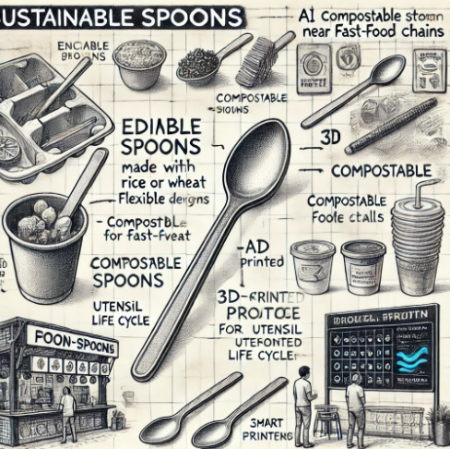
Conclusion:
It has been a challenge and a great experience working on the problem of single-use plastic spoons. During the empathy phase, I learned how plastic spoons are part and parcel of life for most people. It is here that one discerns where the tussle is between environmental consideration and convenience, cost, and ease of use. Talking to busy professionals, students, and fast food workers all adds clarity to the struggles and needs.
We moved on to define the problem based on all the information gathered from the empathy stage and clearly defined the problem. Thus, we realized that plastic spoons are bad for the environment; however, people find it difficult to stop using them because they are relatively cheap and easy.
In turn, by focusing on what was most important to users affordable and convenient eco-friendly alternatives were able to start thinking about solutions that would actually work. Thus, the whole process taught me how tough it is to be able to solve real problems in the world. It is not strictly about the environment, but also, most importantly, making life easy and affordable for people.
Really understanding what a user needs focused me on a solution that fits into their lives.

Slide 37
CREATIVE MATRIX
 | 1)How might we design sustainable spoons for fast-paced lifestyle? | 2)How might we make sustainable spoons affordable for students? | 3)How might we reduce environmental impact while maximizing worker efficiency?
Product | Edible spoons made up from rice/wheat. should be made to be flexible or with bent. | spoons made from agriculture Products. Lightweight and less/affordable cost. | compostable spoons for large-scale fast food chains.
Service | home delivery of eco-utensils mainly in utensils kits. fast food centres. | setup the utensil stations(different types of spoons availability) near the food stalls. | Training programs for fast food workers.
Technology | Equip washing stations with smart sensors to detect utensil type, material, and cleanliness level. | AI to optimize the production cost. printing 3d type spoons and with attractive design patterns. | Use AI to produce efficiency by reducing manual maintain time.
Advertisement Campaign | highlighting the speed and convenience of eco-friendly materials. makes more interest among on-go customers to buy. | you tube challenges promoting eco-friendly choices. | Posters on the work places(Ex: restaurants, stalls, cafes) showing them to reduce the waste.

Slide 38
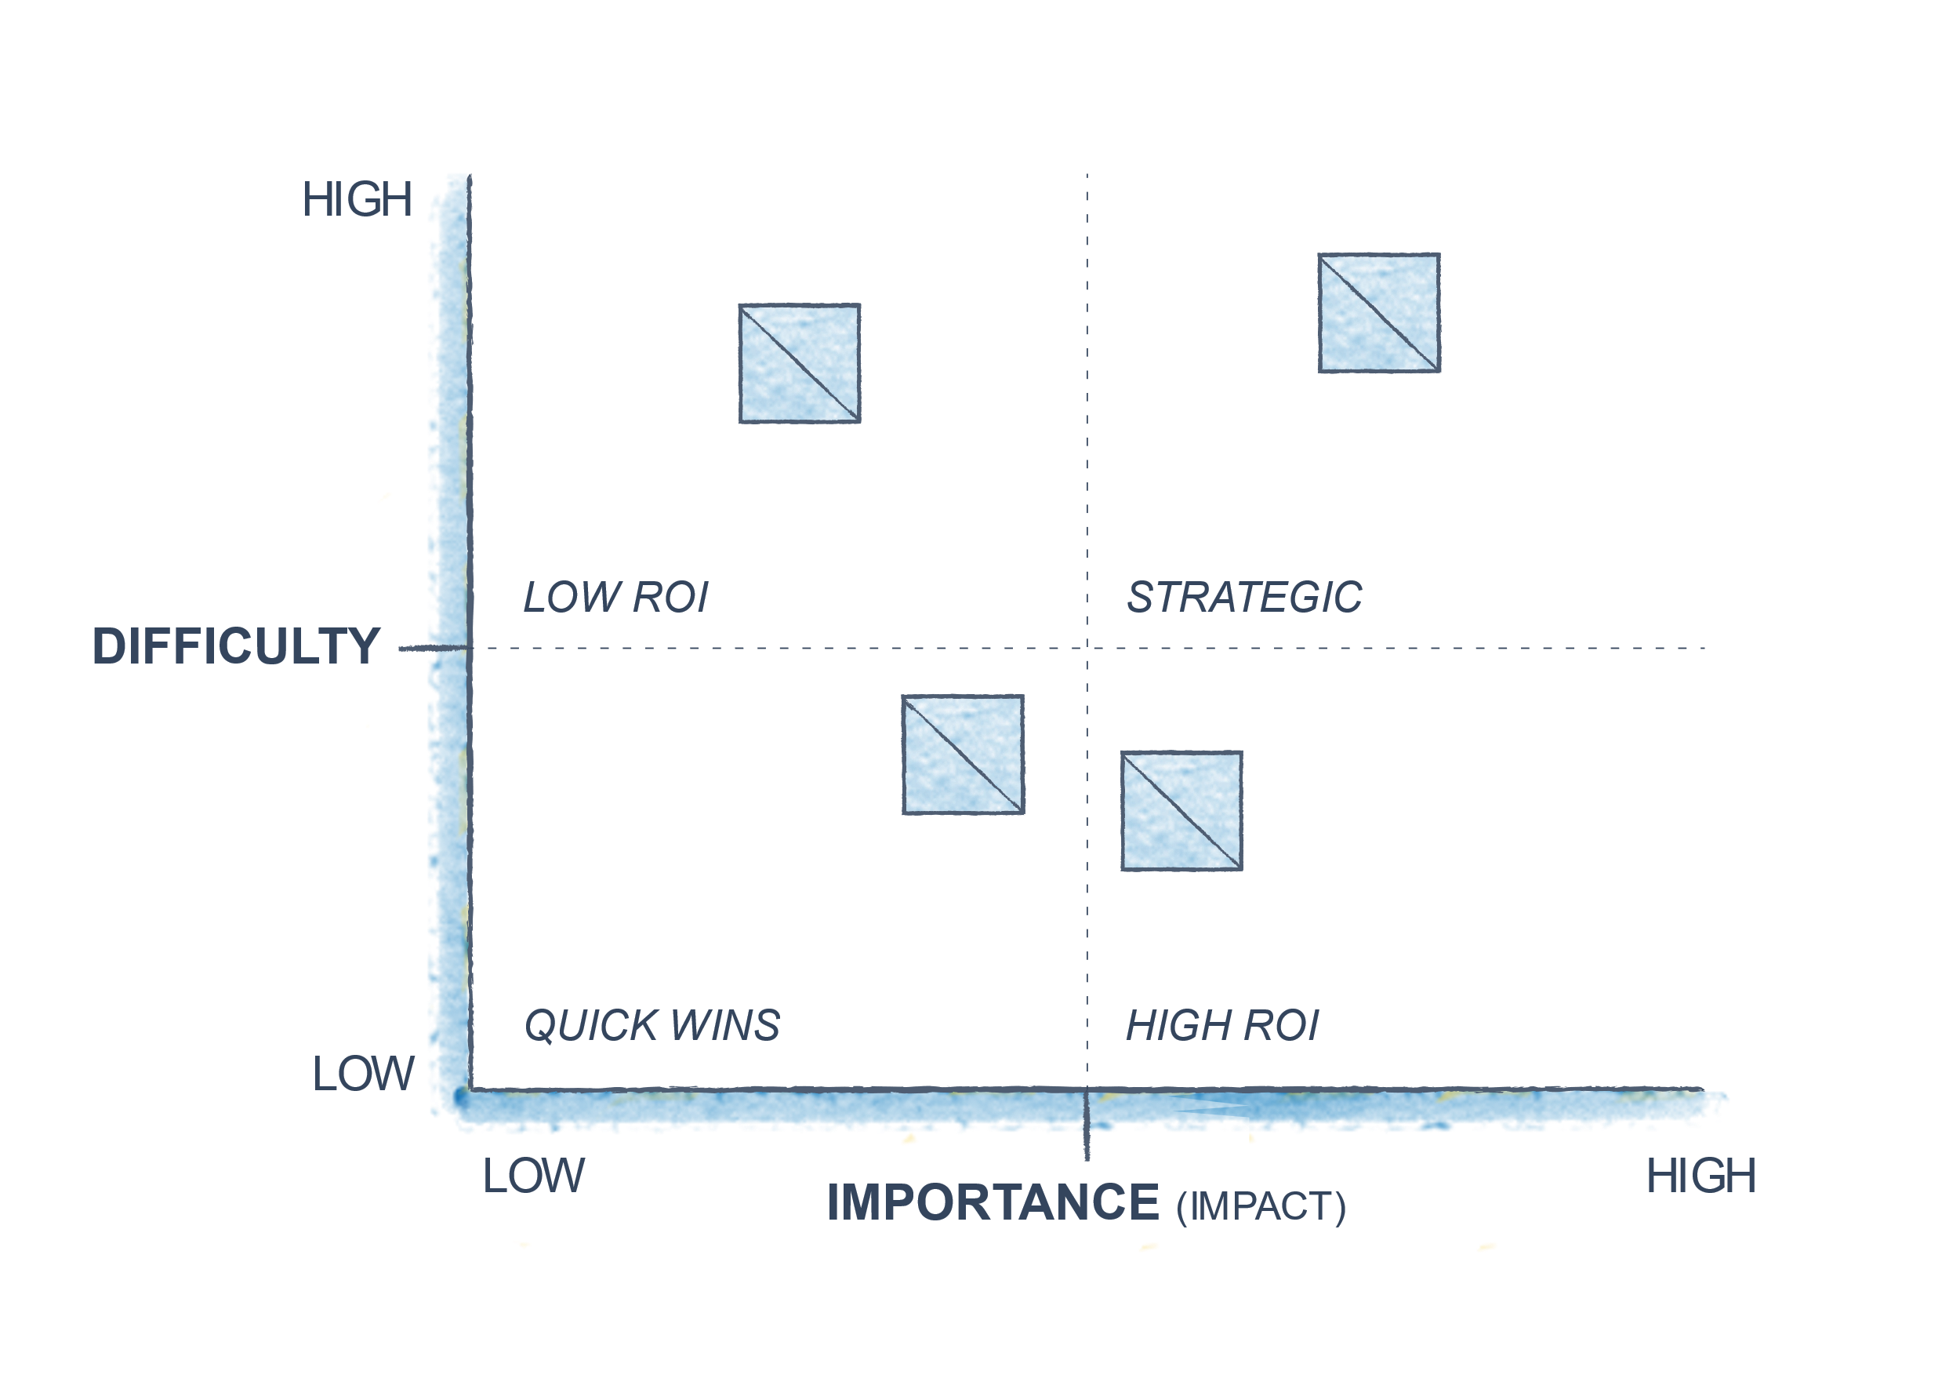

IMPACT & DIFFICULTY MATRIX
Posters promoting eco-friendly choices
Home delivery of eco-utensils
convenience-focused advertisement campaign
Youtube challenges promoting eco-friendly choices
Using blockchain in utensil life tracking and waste management savings measurement. Integrating smart sensors to monitor the reuse and sustainability of eco-friendly spoons. Training programs for fast-food workers on the effective use of sustainable spoons.
Posters at workplaces, like restaurants and cafes, to stimulate waste reduction and sustainability. Home delivery of eco-friendly utensil kits to convenience store. Highlighting speed and convenience in marketing campaigns to attract on-the-go customers.
1)bio-degradable spoons for fast food chains
2)Ai- Ai-optimization for product production without human presence and edible spoons from rice/wheat
3) bio-utensil stations near food stalls
4)Training programs for fast food workers to promote spoons(by knowing how we can keep environment free from plastic and avoiding direct consumption through plastic)

Slide 39
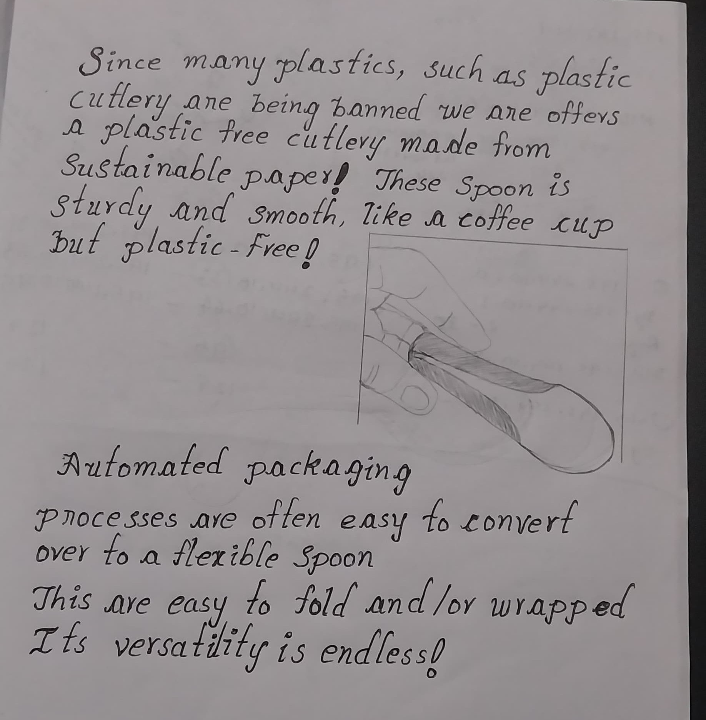
Low Fidelity Prototype (final idea) –

Slide 40
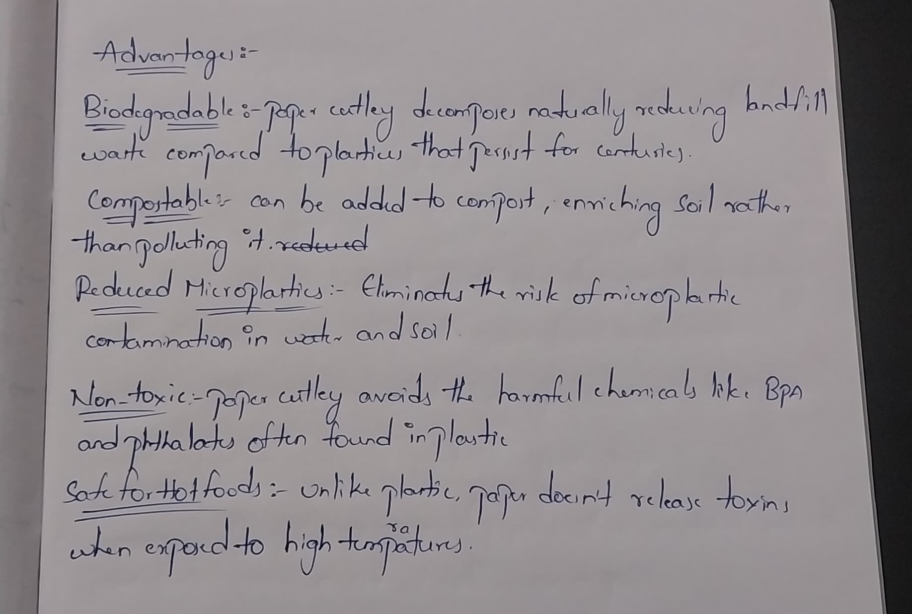
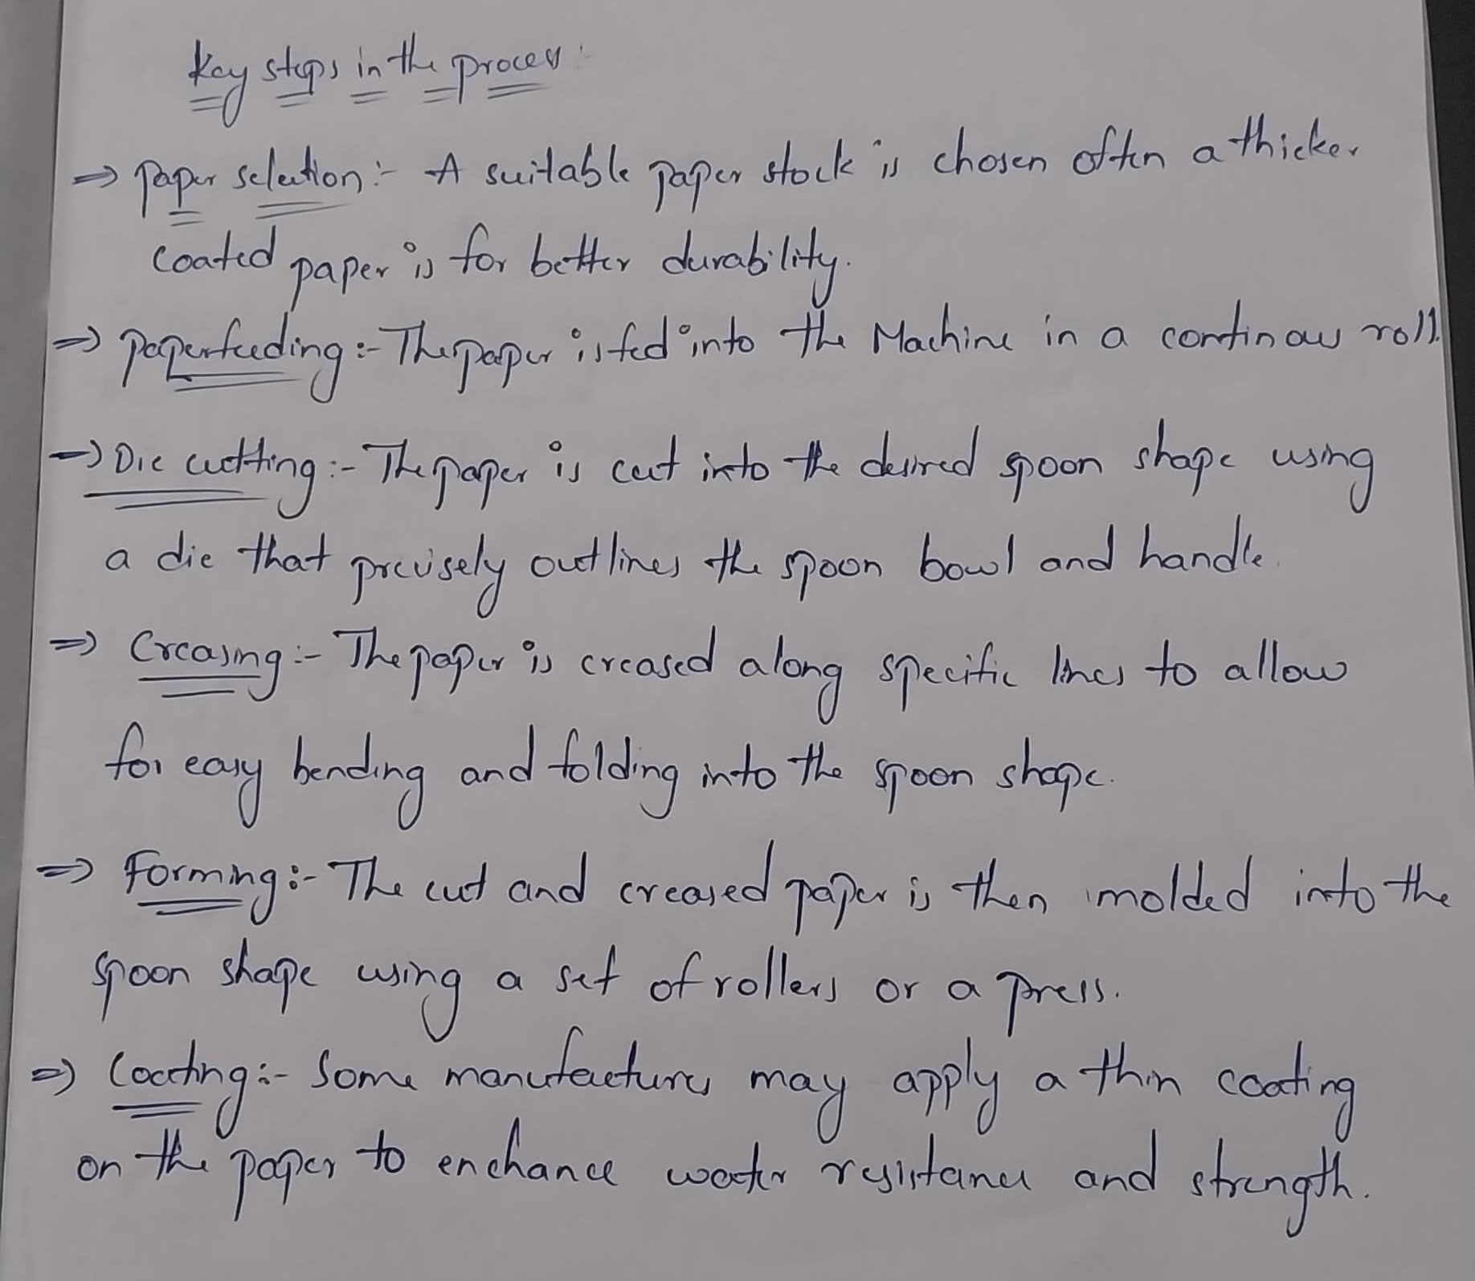

Slide 41

Thank you

